Slide 1
Level 1: Azure Data Fundamentals Expected Salary: Entry-level: ₹4,00,000 - ₹6,00,000 per annum With extensive project work: ₹6,00,000 - ₹8,00,000 per annum

Slide 2
Introduction to Microsoft Azure Fundamentals
Microsoft Azure is a cloud computing platform with an ever-expanding set of services. Azure services support everything from simple to complex.
Azure has simple web services for hosting your business presence in the cloud. Azure also supports running fully virtualized computers managing your custom software solutions.
Azure provides a wealth of cloud-based services like remote storage, database hosting, and centralized account management. Azure also offers new capabilities like artificial intelligence (AI) and Internet of Things (IoT) focused services.

Slide 3
What is Azure Fundamentals?
Azure Fundamentals is a series of three learning paths that familiarize you with Azure and its many services and features. Whether you're interested in compute, networking, or storage services; learning about cloud security best practices; or exploring governance and management options, think of Azure Fundamentals as your curated guide to Azure.
Azure Fundamentals includes interactive exercises that give you hands-on experience with Azure. Many exercises provide a temporary Azure portal environment called the sandbox, which allows you to practice creating cloud resources for free at your own pace. Technical IT experience isn't required; however, having general IT knowledge will help you get the most from your learning experience.

Slide 4
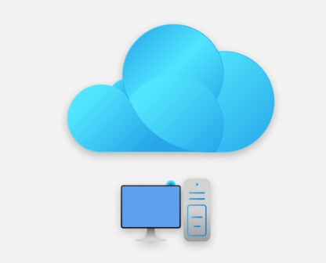
Why should I take Azure Fundamentals?
No matter your goals, Azure Fundamentals has something for you. You should take this course if you:
Have general interest in Azure or in cloud computing
Want to earn official certification from Microsoft (AZ-900)

Slide 5
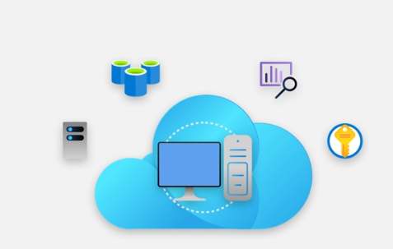
Introduction to cloud computing
After completing this module, you’ll be able to:
Define cloud computing.
Describe the shared responsibility model.
Define cloud models, including public, private, and hybrid.
Identify appropriate use cases for each cloud model.
Describe the consumption-based model.
Compare cloud pricing models.

Slide 6
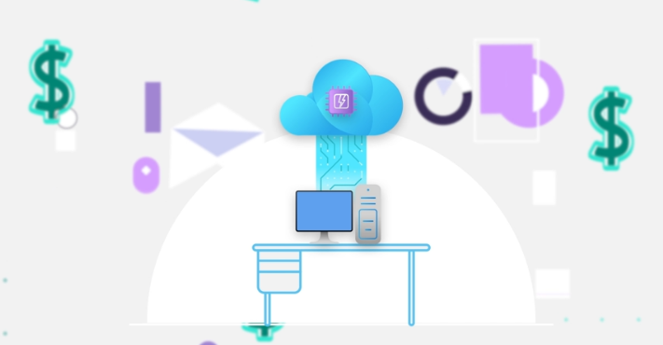
What is cloud computing
Cloud computing is the delivery of computing services over the internet.
Computing services include common IT infrastructure such as virtual machines, storage, databases, and networking.
Cloud services also expand the traditional IT offerings to include things like Internet of Things (IoT), machine learning (ML), and artificial intelligence (AI).

Slide 7
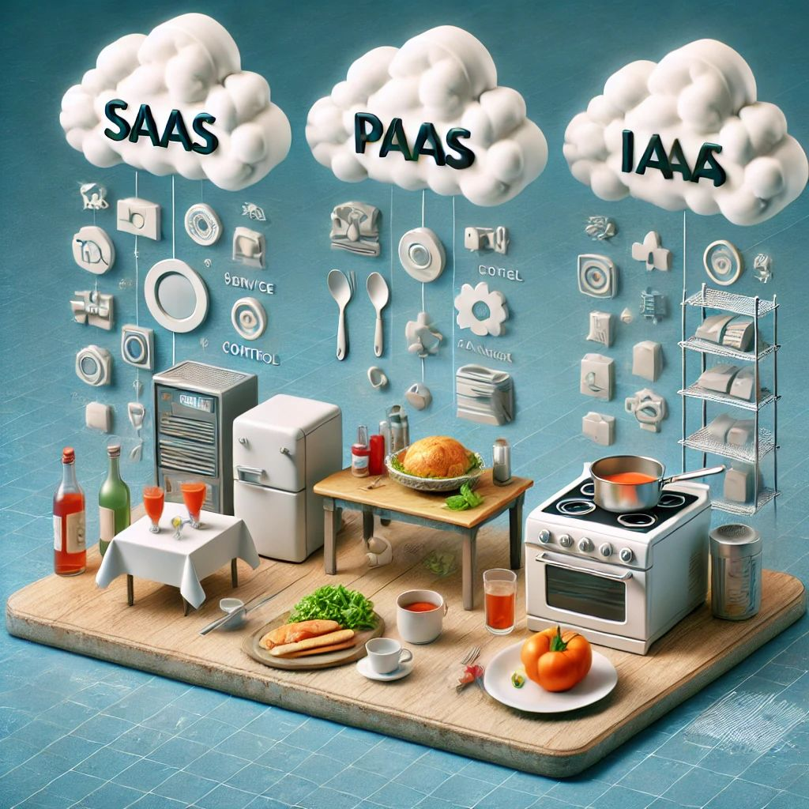
Describe the shared responsibility model
IaaS is like going to the market, buying all the ingredients, and then using your gas to cook a meal. You have all the control, but you also do all the work.
PaaS is like going to a restaurant, buying a pot of soup, and then coming home to make your swallow. You are still involved, but the core elements are taken care of. SaaS is like going to a restaurant, ordering a complete meal, eating it there, and then simply returning home. Everything is being taken care of —no prep, no cooking, and no cleanup.

Slide 8
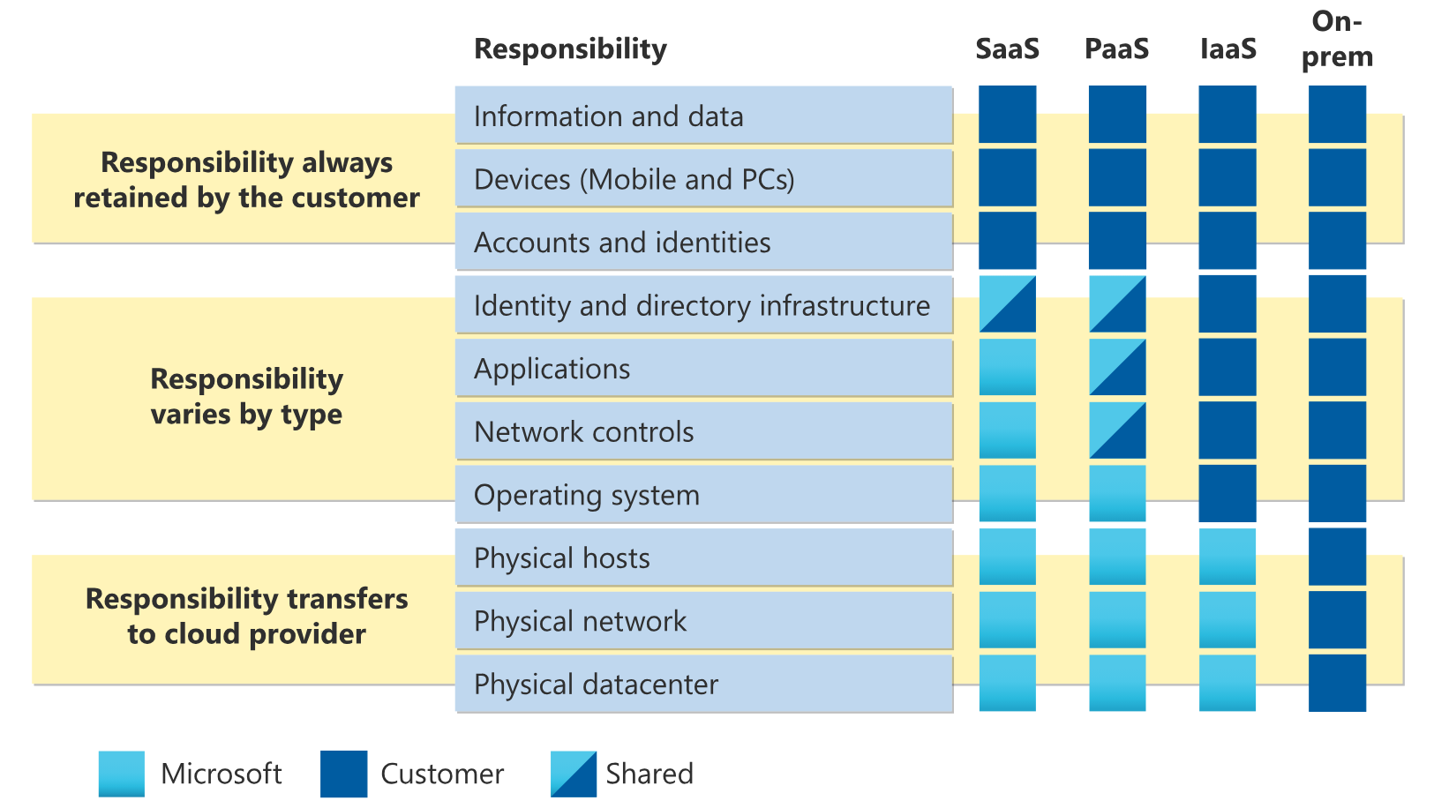
Describe the shared responsibility model

Slide 9
Describe the shared responsibility model
When using a cloud provider, you’ll always be responsible for:
The information and data stored in the cloud
Devices that are allowed to connect to your cloud (cell phones, computers, and so on)
The accounts and identities of the people, services, and devices within your organization

Slide 10
Describe the shared responsibility model
The cloud provider is always responsible for:
The physical datacenter
The physical network
The physical hosts

Slide 11
Describe the shared responsibility model
Your service model will determine responsibility for things like:
Operating systems
Network controls
Applications
Identity and infrastructure

Slide 12
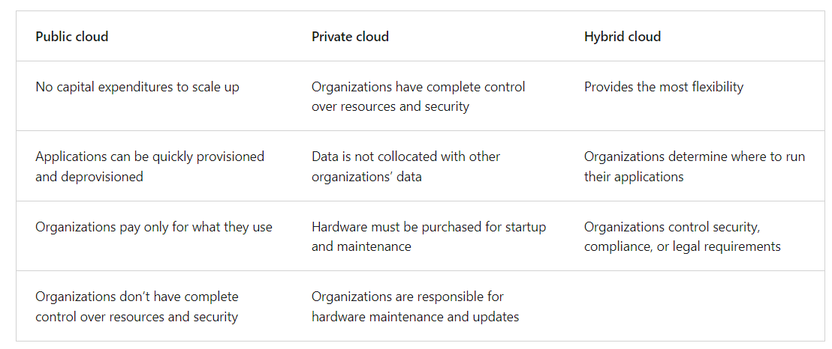
Define cloud models

Slide 13
Describe the benefits of high availability and scalability in the cloud
High availability
When you’re deploying an application, a service, or any IT resources, it’s important the resources are available when needed. High availability focuses on ensuring maximum availability, regardless of disruptions or events that may occur.
When you’re architecting your solution, you’ll need to account for service availability guarantees. Azure is a highly available cloud environment with uptime guarantees depending on the service. These guarantees are part of the service-level agreements (SLAs).

Slide 14
Describe the benefits of high availability and scalability in the cloud
Scalability
Another major benefit of cloud computing is the scalability of cloud resources. Scalability refers to the ability to adjust resources to meet demand. If you suddenly experience peak traffic and your systems are overwhelmed, the ability to scale means you can add more resources to better handle the increased demand.
The other benefit of scalability is that you aren't overpaying for services. Because the cloud is a consumption-based model, you only pay for what you use. If demand drops off, you can reduce your resources and thereby reduce your costs.
Scaling generally comes in two varieties: vertical and horizontal. Vertical scaling is focused on increasing or decreasing the capabilities of resources. Horizontal scaling is adding or subtracting the number of resources.

Slide 15
Describe the benefits of high availability and scalability in the cloud
Vertical scaling
With vertical scaling, if you were developing an app and you needed more processing power, you could vertically scale up to add more CPUs or RAM to the virtual machine. Conversely, if you realized you had over-specified the needs, you could vertically scale down by lowering the CPU or RAM specifications.

Slide 16
Describe the benefits of high availability and scalability in the cloud
Horizontal scaling
With horizontal scaling, if you suddenly experienced a steep jump in demand, your deployed resources could be scaled out (either automatically or manually). For example, you could add additional virtual machines or containers, scaling out. In the same manner, if there was a significant drop in demand, deployed resources could be scaled in (either automatically or manually), scaling in.

Slide 17
Describe the benefits of reliability and predictability in the cloud
Reliability
Reliability is the ability of a system to recover from failures and continue to function. It's also one of the pillars of the Microsoft Azure Well-Architected Framework.
The cloud, by virtue of its decentralized design, naturally supports a reliable and resilient infrastructure. With a decentralized design, the cloud enables you to have resources deployed in regions around the world. With this global scale, even if one region has a catastrophic event other regions are still up and running.

Slide 18
Describe the benefits of reliability and predictability in the cloud
Predictability
Predictability in the cloud lets you move forward with confidence. Predictability can be focused on performance predictability or cost predictability. Both performance and cost predictability are heavily influenced by the Microsoft Azure Well-Architected Framework. Deploy a solution built around this framework and you have a solution whose cost and performance are predictable.

Slide 19
Describe the benefits of reliability and predictability in the cloud
Performance
Performance predictability focuses on predicting the resources needed to deliver a positive experience for your customers. Autoscaling, load balancing, and high availability are just some of the cloud concepts that support performance predictability. If you suddenly need more resources, autoscaling can deploy additional resources to meet the demand, and then scale back when the demand drops. Or if the traffic is heavily focused on one area, load balancing will help redirect some of the overload to less stressed areas.

Slide 20
Describe the benefits of reliability and predictability in the cloud
Cost
Cost predictability is focused on predicting or forecasting the cost of the cloud spend. With the cloud, you can track your resource use in real time, monitor resources to ensure that you’re using them in the most efficient way, and apply data analytics to find patterns and trends that help better plan resource deployments. By operating in the cloud and using cloud analytics and information, you can predict future costs and adjust your resources as needed. You can even use tools like the Total Cost of Ownership (TCO) or Pricing Calculator to get an estimate of potential cloud spend.

Slide 21
Describe the benefits of manageability in the cloud
Management of the cloud
Management of the cloud speaks to managing your cloud resources. In the cloud, you can:
Automatically scale resource deployment based on need.
Deploy resources based on a preconfigured template, removing the need for manual configuration.
Monitor the health of resources and automatically replace failing resources.
Receive automatic alerts based on configured metrics, so you’re aware of performance in real time.

Slide 22
Describe the benefits of manageability in the cloud
Management in the cloud
Management in the cloud speaks to how you’re able to manage your cloud environment and resources.
You can manage these:
Through a web portal.
Using a command line interface.
Using APIs.
Using PowerShell.

Slide 23
Thanking you !!!
Any Question !!!!

